Slide 1
Review for midterm exam

Slide 2
In Chapter 1 we cover …
Individuals and variables
Categorical variables: pie charts and bar graphs
Quantitative variables: histograms
Interpreting histograms
Quantitative variables: stemplots
Time plots

Slide 3
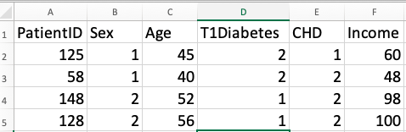
Types of Variables
A categorical variable places individuals into one of several groups or categories.
A quantitative variable takes numerical values for which arithmetic operations make sense (usually recorded in a unit of measurement).
Most data tables follow this format—the data here appear in a spreadsheet program.

Slide 4
Displaying Categorical Data

Slide 5
Pie Chart
EXAMPLE: What do the 1.5 million full-time first-year students plan to study? Here are data on the percents of post-secondary first-year students who plan to major in several discipline areas.
Field of Study | Percent of Student
Biological sciences | 15.5
Business | 13.8
Health professions | 11.7
Engineering | 11.5
Social sciences | 11
Arts and humanities | 8.8
Math and computer science | 6.2
Education | 4.4
Physical sciences | 2.7
Other majors and undeclared | 13.1
Total | 98.7
rounding error

Slide 6
Pie Charts or Bar Graphs
EXAMPLE (cont’d): Here are data on the percents of post-secondary first-year students who plan to major in several discipline areas, now alphabetized by field of study.
Field of Study | Percent of Student
Biological sciences | 15.5
Business | 13.8
Health professions | 11.7
Engineering | 11.5
Social sciences | 11
Arts and humanities | 8.8
Math and computer science | 6.2
Education | 4.4
Physical sciences | 2.7
Other majors and undeclared | 13.1

Slide 7
Bar Graphs Only
EXAMPLE: What sources do Americans aged 12–34 years use to keep up to date and learn about music?
Brand | Percent of 12-34s Who Have Listened to Each Brand
Pandora | 36
Spotify | 46
iHeartRadio | 14
Apple Music | 20
Amazon Music | 10
SoundCloud | 23
Google Play All Access | 8
Note: For bar graphs, percents don’t necessarily add to 100.

Slide 8
Displaying Quantitative Data

Slide 9
Histograms and Overall Shape of Distributions
Uniform distribution
Symmetric
Right-skewed
Left-skewed

Slide 10
Stemplots (Stem-and-Leaf Plots)
EXAMPLE:
5.3, 5.6, 5.3, 5.0, 5.5, 5.9, 5.9, 3.3, 5.0, 3.4, 5.0, 3.4, 4.6, 6.9, 6.0
Stems are the non-decimals, leaves are decimals and ordered
3.3, 3.4, 3.4, 4.6, 5.0, 5.0, 5.0, 5.3, 5.3, 5.5, 5.6, 5.9, 5.9, 6.0, 6.9
3 | 344
4 | 6
5 | 000335699
6 | 09

Slide 11
Stemplots (Stem-and-Leaf Plots)
If there are very few stems (that is, when the data cover only a very small range of values), then we may want to create more stems by splitting the original stems.
EXAMPLE:
3.3, 3.4, 3.4, 4.6, 5.0, 5.0, 5.0, 5.3, 5.3, 5.5, 5.6, 5.9, 5.9, 6.0, 6.9
3 | 344 → decimals 0 to 4
3 | → decimals 5 to 9
4 |
4 | 6
5 | 00033
5 | 5699
6 | 0
6 | 9

Slide 12
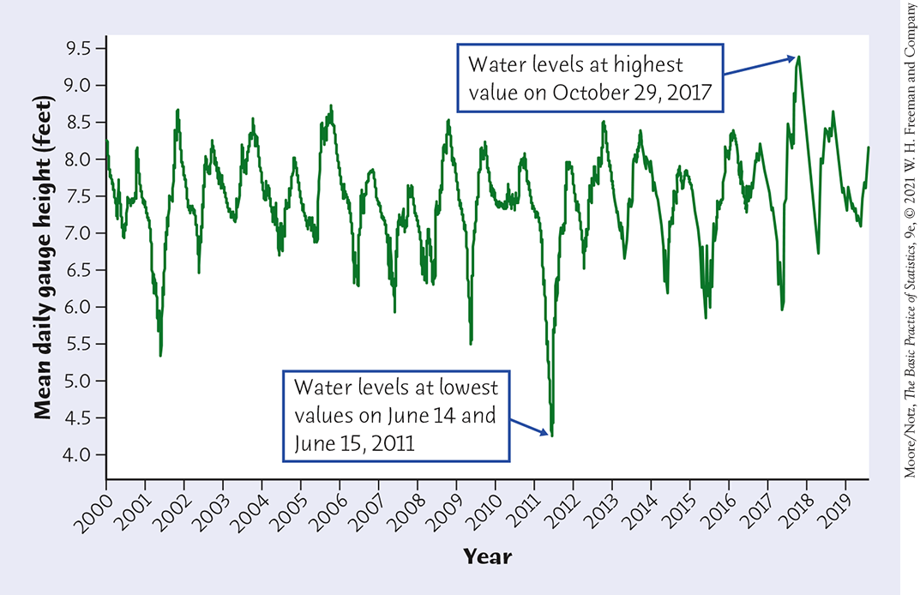
Time Plots
Time Plot of Average Gauge Height,
Everglades National Park Monitoring Station

Slide 13
In Chapter 2 we cover …
Measuring center: the mean
Measuring center: the median
Comparing the mean and the median
Measuring variability: the quartiles
The five-number summary and boxplots
Spotting suspected outliers and the modified boxplot
Measuring variability: the standard deviation
Choosing measures of center and variability

Slide 14
Measuring center
Use the data below to calculate the mean and median of the commuting times (in minutes) of 15 randomly selected North Carolina workers.
20 | 35 | 8 | 70 | 5 | 15 | 25 | 30
40 | 35 | 10 | 12 | 40 | 15 | 20
Mean:
Median (odd number of observations):
Remember to sort the numbers from smallest to largest to calculate the median!
5 8 10 12 15 15 20 20 25 30 35 35 40 40 70
M = 20
The median is resistant (or robust) measure of center because it resists the influence of extreme observations.
The mean is not a robust measure of center.

Slide 15
Measuring center
Use the data below to calculate the mean and median of the commuting times (in minutes) of 16 randomly selected North Carolina workers.
20 | 35 | 8 | 70 | 5 | 15 | 25 | 30
40 | 35 | 10 | 12 | 40 | 15 | 20 | 28
Median (even number of observations):
5 8 10 12 15 15 20 20 25 28 30 35 35 40 40 70
M = (20 + 25) / 2 = 22.5

Slide 16
Comparing the mean and the median
Example: skewed to the left distribution
Mean = 83.09326 < Median = 85.72406

Slide 17
Comparing the mean and the median
Example: skewed to the right distribution
Mean = 5.026254 > Median = 4.450805

Slide 18
Comparing the mean and the median
Example: symmetric distribution
Median and mean approx. 10

Slide 19
Five-number summary
The five-number summary of a distribution consists of the smallest observation, the first quartile, the median, the third quartile, and the largest observation—written in order from smallest to largest.
Minimum Q₁ M Q₃ Maximum

Slide 20
Example
78,95,60,93,55,84,76,92,62,83,80,90,64,75,79,32,75,64,98,73,88,61,82,68,79,78,80,85
Create a five-number summary for these 28 scores.

Slide 21
Example
78,95,60,93,55,84,76,92,62,83,80,90,64,75,79,32,75,64,98,73,88,61,82,68,79,78,80,85
Create a five-number summary for these 28 scores.
32 55 60 61 62 64 64 68 73 75 75 76 78 78 79 79 80 80 82 83 84 85 88 90 92 93 95 98
Position (28+1)/2 =14.5, so take average between positions 14 and 15
Minimum = 32 Q₁ M = 78.5 Q₃ Maximum = 98

Slide 22
Example
78,95,60,93,55,84,76,92,62,83,80,90,64,75,79,32,75,64,98,73,88,61,82,68,79,78,80,85
Create a five-number summary for these scores.
32 55 60 61 62 64 64 68 73 75 75 76 78 78 79 79 80 80 82 83 84 85 88 90 92 93 95 98
Position (14+1)/2 =7.5, so take average between positions 7 and 8 → (64+68)/2 =66
Minimum = 32 Q₁ = 66 M = 78.5 Q₃ Maximum = 98

Slide 23
Example
78,95,60,93,55,84,76,92,62,83,80,90,64,75,79,32,75,64,98,73,88,61,82,68,79,78,80,85
Create a five-number summary for these scores.
32 55 60 61 62 64 64 68 73 75 75 76 78 78 79 79 80 80 82 83 84 85 88 90 92 93 95 98
Minimum = 32 Q₁= 66 M = 78.5 Q₃ = 84.5 Maximum = 98

Slide 24
Spotting suspected outliers
The interquartile range, or IQR, is the distance between the first and third quartiles
IQR = Q₃ – Q₁
In addition to serving as a measure of spread, the interquartile range (IQR) is used as part of a rule of thumb for identifying outliers.
The 1.5 × IQR Rule for Outliers
Call an observation a suspected outlier if it falls more than 1.5 × IQR above the third quartile or below the first quartile.
Notes:
*Material marked with an asterisk (*) is optional

Slide 25
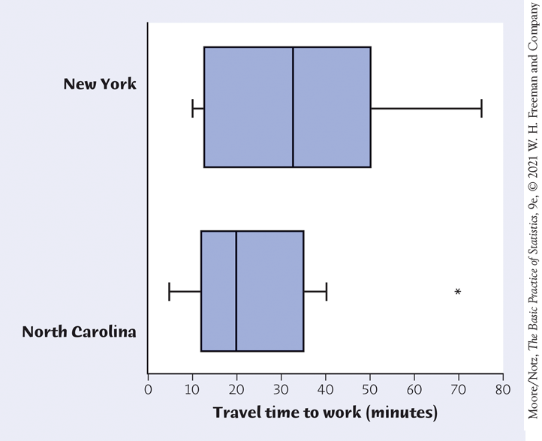
Boxplots (modified boxplots*)
The five-number summary divides the distribution roughly into quarters. This leads to a new way to display quantitative data, the boxplot.
*In the textbook, they present boxplots and then modified boxplots, here I am focusing only on
the modified version, which is the one used by most software packages.

Slide 26
Boxplots (modified boxplots*)
The five-number summary divides the distribution roughly into quarters. This leads to a new way to display quantitative data, the boxplot.
How to Make a Boxplot:
A central box spans the quartiles Q₁ and Q₃.
A line in the box marks the median M.
Compute IQR (interquartile range) = distance between quartiles.
Compute 1.5 x IQR; outlier is any value more than this distance from closest quartile.
Draw line (whisker) from each end of box extending to farthest data value that is not an outlier. (If no outlier, then to min and max.)
Draw asterisks to indicate the outliers.
*In the textbook, they present boxplots and then modified boxplots, here I am focusing only on
the modified version, which is the one used by most software packages.

Slide 27
Measuring variability: standard deviation
The most common measure of spread looks at how far each observation is from the mean.
Find the mean.
Find the deviation of each value from the mean. Deviation = value – mean.
Square the deviations.
Find the “average” squared deviation by calculating the sum of the squared deviations divided by (n - 1). This is the variance.
Take the square root of the variance. The result is the standard deviation.

Slide 28
Computing the Standard Deviation
Try it for the set of values: 90, 90, 100, 110, 110.
The mean is 100.
The deviations are -10, -10, 0, 10, 10.
The squared deviations are 100, 100, 0, 100, 100.
The sum of the squared deviations is 400. The variance = 400/(5 – 1) = 400/4 = 100.
The standard deviation is the square root of 100, or 10.
Value | Deviation | Deviation²
90 | 100-90 = 10 | 100
90 | 10 | 100
100 | 0 | 0
110 | -10 | 100
110 | -10 | 100
Mean = (90+90+100+110+1110 = 500) ÷ 5 = 100 |  | Variance = (100 + 100 + 0 +100 + 100) ÷ (5-1) = 400/4 = 100 Standard Deviation (SD) = sqrt(100) = 10

Slide 29

Choosing measures of center and variability
The five-number summary is usually better than the mean and standard deviation for describing a skewed distribution or a distribution with strong outliers.
Use $\overline{x}$ and s only for reasonably symmetric distributions that are free of outliers.

Slide 30
In Chapter 3, we cover …
Density curves
Describing density curves
Normal distributions
The 68–95–99.7 rule
The standard Normal distribution
Finding Normal proportions
Using the standard Normal table
Finding a value given a proportion

Slide 31
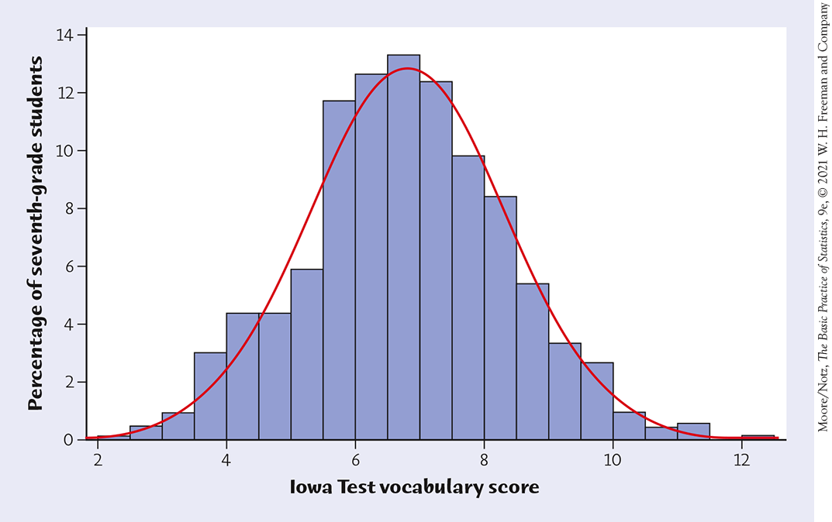
Density Curves
Example: Here is a histogram of the vocabulary scores of 947 seventh-graders.
The smooth curve closely approximates the tops of the histogram bars and provides a good description of the overall data pattern.

Slide 32
Density Curves
A density curve is a curve that:
is always on or above the horizontal axis.
has an area of exactly 1 underneath it.
A density curve describes the overall pattern of a distribution. The area under the curve and above any range of values on the horizontal axis is the proportion (or probability) of all observations that fall in that range.
Caution: No set of real data is exactly described by a density curve. The curve is an idealized description that is easy to use and accurate enough for practical use.

Slide 33
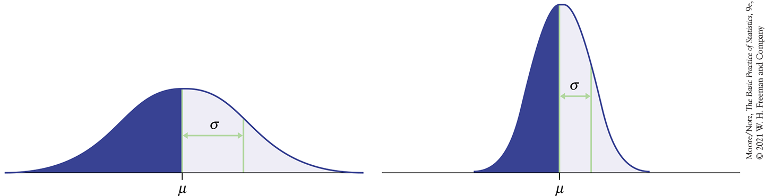
Normal Distributions
One particularly important class of density curve comprises Normal curves, which describe Normal distributions.
All Normal curves are symmetric, single-peaked, and bell-shaped.
Any specific Normal curve is completely described by giving its mean $μ$ and standard deviation $σ$.

Slide 34
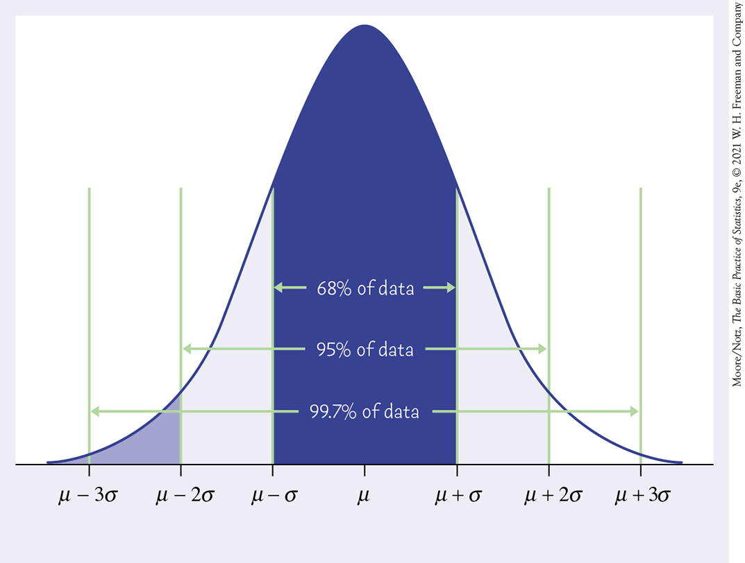
Normal Distributions
In the Normal distribution, with mean $μ$ and standard deviation $σ$:
approximately 68% of the observations fall within $σ$ of $μ$.
approximately 95% of the observations fall within 2$σ$ of $μ$.
approximately 99.7% of the observations fall within 3$σ$ of $μ$.
The 68–95–99.7 Rule

Slide 35
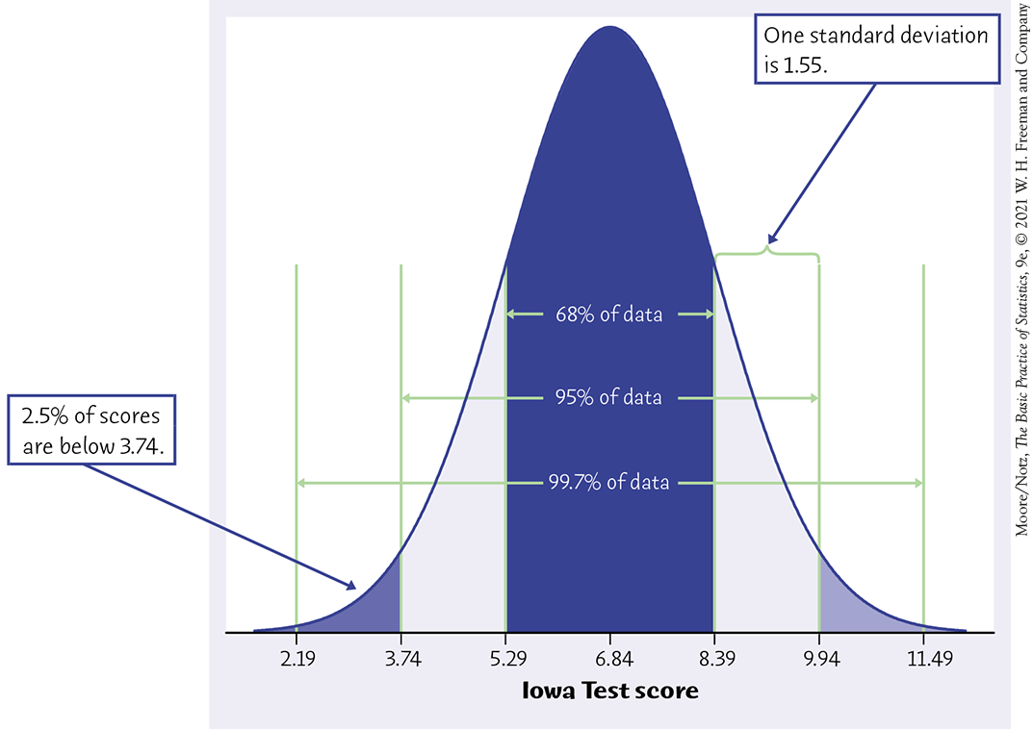
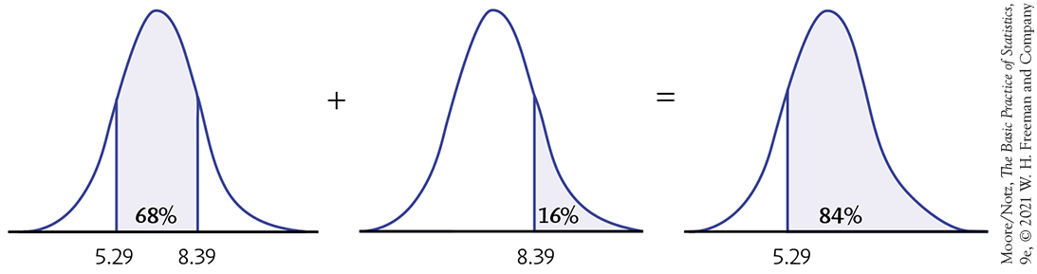
Normal Distributions

Slide 36
Standardizing
All Normal distributions are the same if we measure in units of size $σ$ from the mean $μ$ as center.
Changing to these units is called standardizing.
STANDARDIZING AND z-SCORES
If $x$ is an observation from a distribution that has mean $μ$ and standard deviation $σ$, then the standardized value of $x$ is
$$z=\frac{x−μ}{σ}$$
A standardized value is often called a z-score.

Slide 37
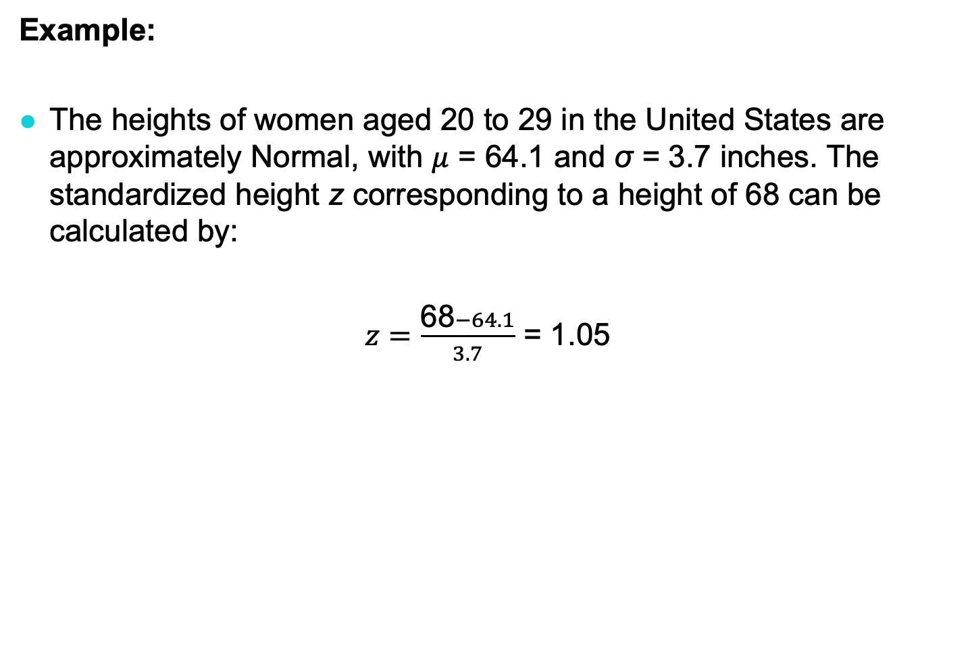
Standardizing
Example:
The heights of women aged 20 to 29 in the United States are approximately Normal, with $μ$ = 64.1 and σ = 3.7 inches. The standardized height z corresponding to a height of 68 can be calculated by:
$z=\frac{\text{68}−64.1}{3.7}$ = 1.05

Slide 38
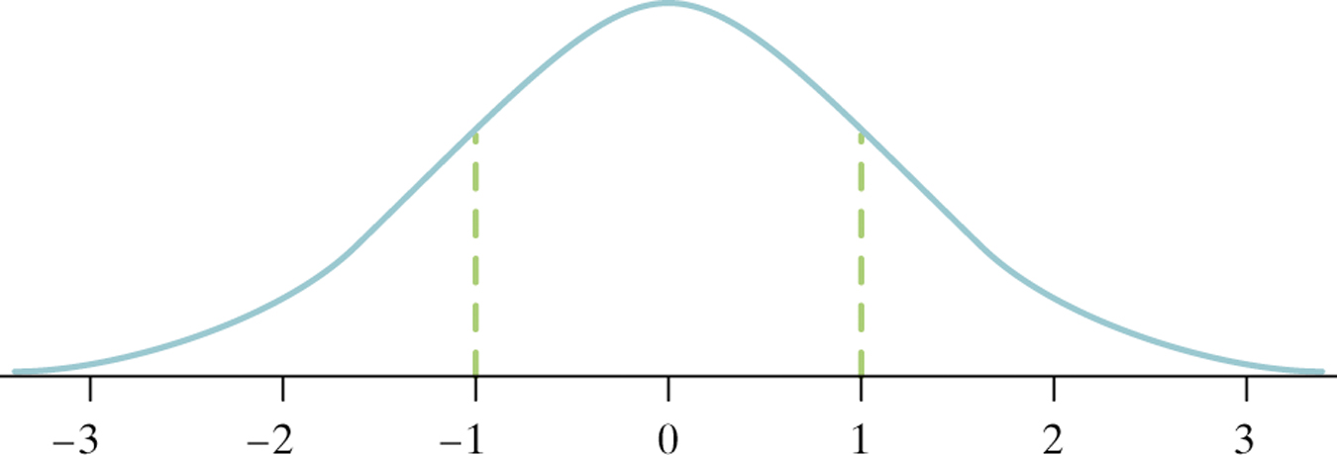
The Standard Normal Distribution
The standard Normal distribution is the Normal distribution with mean 0 and standard deviation 1.
If a variable $x$ has any Normal distribution $N\left(μ,σ\right)$, with mean $μ$ and standard deviation $σ$, then the standardized variable
$$z=\frac{x−μ}{σ}$$
has the standard Normal distribution, $N\left(0,1\right)$.

Slide 39
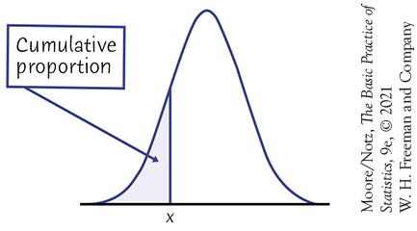
Cumulative Proportions
The cumulative proportion for a value $x$ in a distribution is the proportion of observations in the distribution that are less than or equal to $x$.

Slide 40
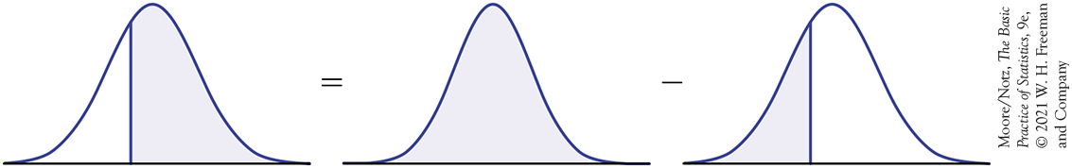
Cumulative Proportions - Example 3.5
Who qualifies for college sports?
The combined scores of the almost 2.2 million high school seniors taking the SAT in 2018 were approximately Normal, with mean 1059 and standard deviation 210. What percent of high school seniors meet this SAT requirement of a combined score of 980 or better?
Here is the calculation in a picture:
980
1059
1059
980
1059

Slide 41
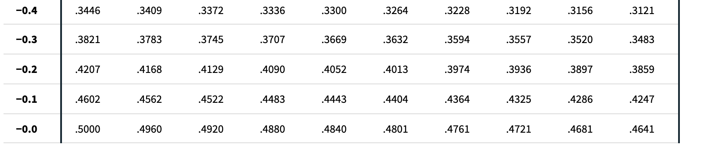
Cumulative Proportions - Example 3.5
What percent of high school seniors meet this SAT requirement of a combined score of 980 or better?
Calculate z-score: z = (980-1059)/210 = - 0.376 → approx. - 0.38
Look at the Normal table for the proportion below z:
Proportion below z = 0.3520
Proportion above z = 1 - 0.3520 = 0.648 → 0.65 or 65%

Slide 42
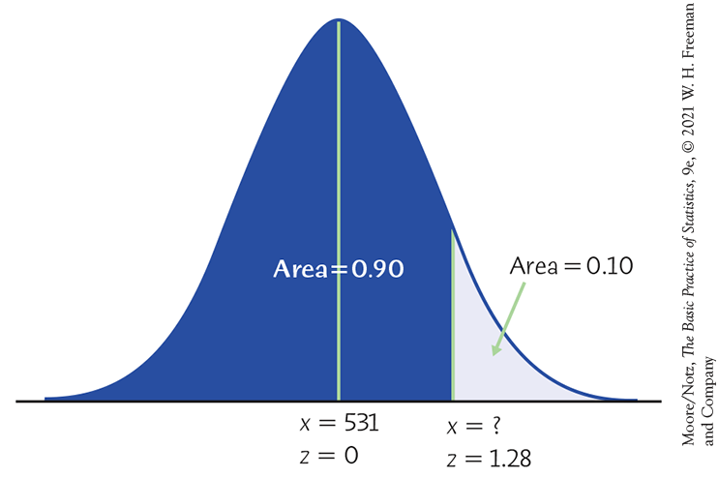
Finding a Value Given a Proportion Example 3.9
SAT reading scores for a recent year are distributed according to an N(531, 104) distribution.
How high must a student score in order to be in the top 10% of the distribution?
In order to use Table A, equivalently, what z-score has the cumulative proportion 0.90 below it?
?

Slide 43

Finding a Value Given a Proportion Example 3.9
How high must a student score in order to be in the top 10% of the distribution?
Look up the closest probability (closest to 0.90) in the table.
Find the corresponding standardized score.
The value you seek is that many standard deviations from the mean.
z | .07 | .08 | .09
1.1 | .8790 | .8810 | .8830
1.2 | .8980 | .8997 | .8015
1.3 | .8147 | .8162 | .8177
$$z=1.28$$

Slide 44
Finding a Value Given a Proportion Example 3.9
How high must a student score in order to be in the top 10% of the distribution?
$$z=1.28$$
We need to “unstandardize” the z-score to find the observed value (x):
$$z= \frac{x −µ}{σ}$$
$$x=μ+zσ$$
$$\begin{matrix}x & = & 531+z∙104 \\ & = & 531+\left[\left(1.28\right)∙104\right] \\ & = & 531+\left(133.12\right)=664.12\end{matrix}$$
x
x
A student would have to score at least 664.12 to be in the top 10% of the distribution of SAT reading scores for this particular year.

Slide 45
In Chapter 4, we cover …
Explanatory and response variables
Displaying relationships: Scatterplots
Interpreting scatterplots
Adding categorical variables to scatterplots
Measuring linear association: Correlation
Facts about correlation

Slide 46
Response Variables and Explanatory Variables
A response variable measures an outcome of a study.
An explanatory variable may explain or influence changes in a response variable.

Slide 47
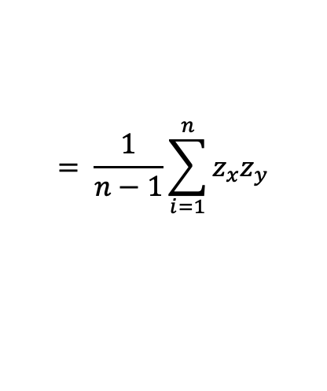
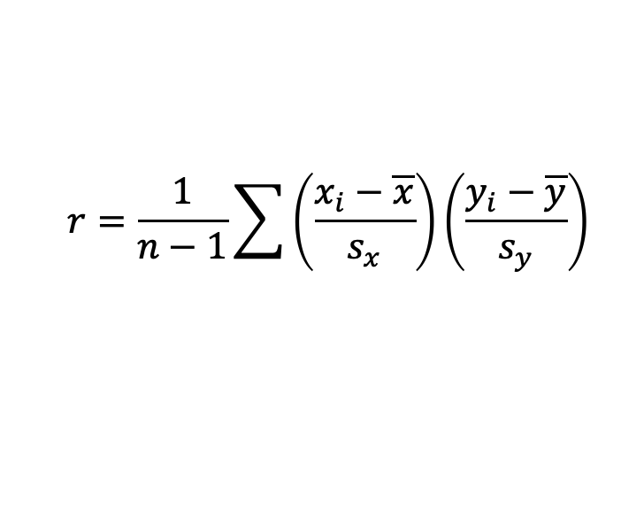
Measuring Linear Association
A scatterplot displays the strength, direction, and form of the relationship between two quantitative variables.
Correlation (or the Pearson correlation coefficient) represented by the letter r: measures the strength of a linear relationship between two measurement variables.
$$r=\frac{1}{n−1}\sum{\left(\frac{x_{i}−\overline{x}}{s_{x}}\right)\left(\frac{y_{i}−\overline{y}}{s_{y}}\right)}$$
n
$$= \frac{1}{n−1}\sum_{i=1}^{n}{{z_{x}z}_{y}}$$
i=1
r is an average of the products of the standardized x and y (z_{x} and z_{y}) for all individuals.
Just as the case for the standard deviation, the “average” here is obtained by dividing by n-1 instead of n.

Slide 48
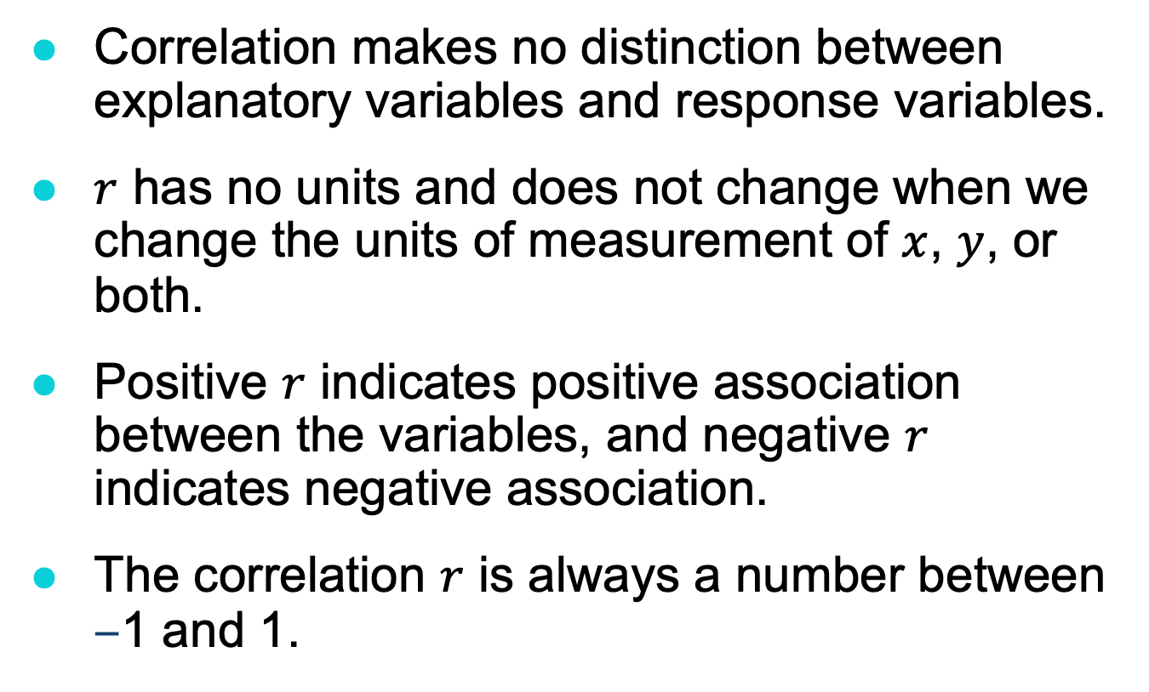
Facts about Correlation (1 of 2)
Correlation makes no distinction between explanatory variables and response variables.
$r$ has no units and does not change when we change the units of measurement of $x$, $y$, or both.
Positive $r$ indicates positive association between the variables, and negative $r$ indicates negative association.
The correlation $r$ is always a number between –1 and 1.

Slide 49
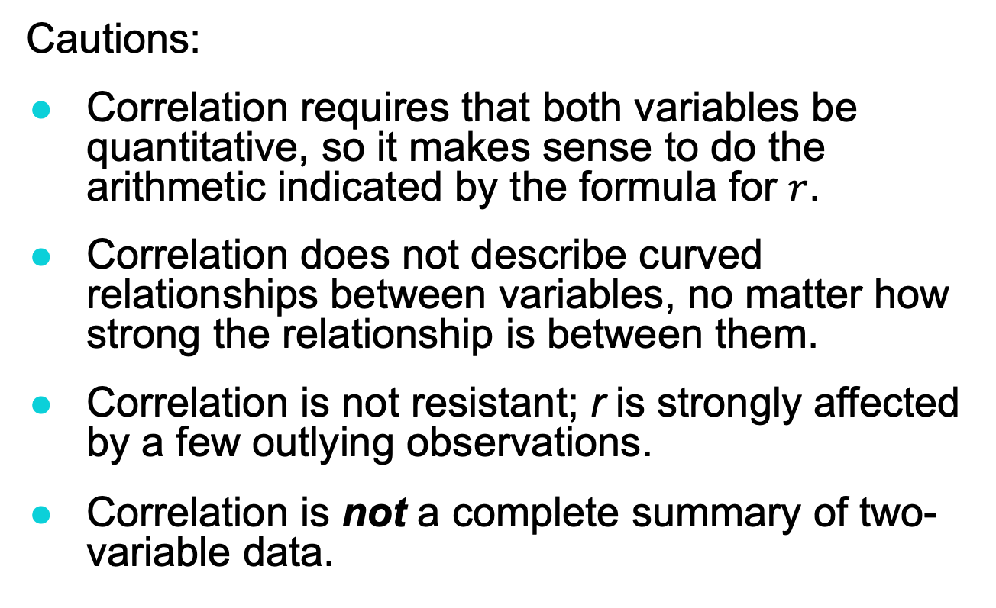
Facts about Correlation (2 of 2)
Cautions:
Correlation requires that both variables be quantitative, so it makes sense to do the arithmetic indicated by the formula for $r$.
Correlation does not describe curved relationships between variables, no matter how strong the relationship is between them.
Correlation is not resistant; r is strongly affected by a few outlying observations.
Correlation is not a complete summary of two-variable data.

Slide 50
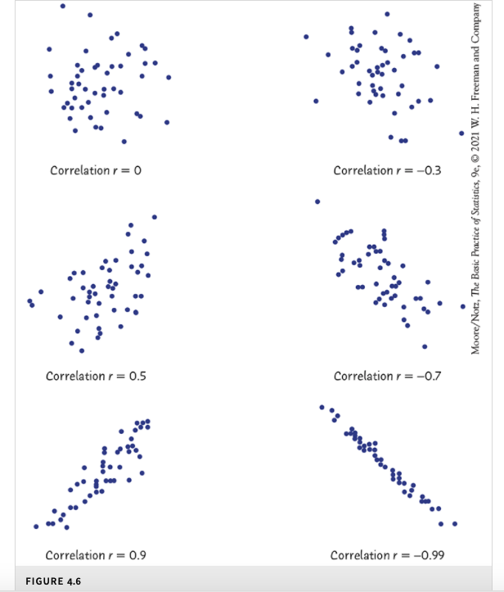
The scatterplots in Figure 4.6
illustrate how values of r closer to 1 or -1 correspond to stronger linear relationships.

Slide 51
In Chapter 5, we cover …
Regression lines
The least-squares regression line
Facts about least-squares regression
Residuals
Outliers and influential observations
Cautions about correlation and regression
Association does not imply causation

Slide 52
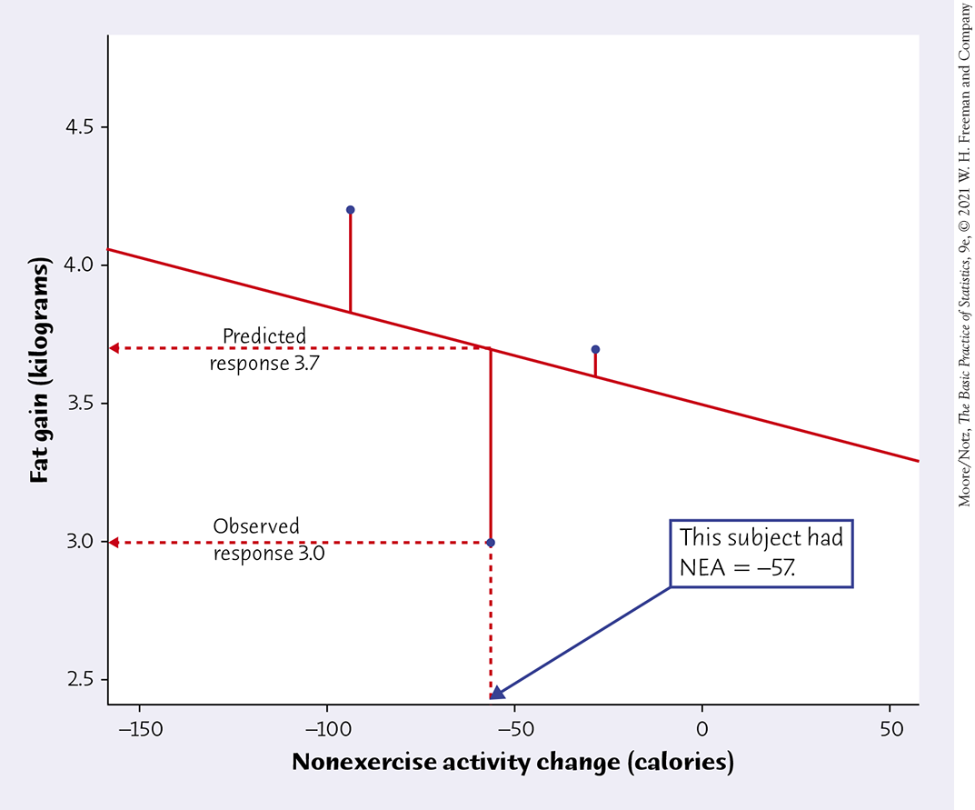
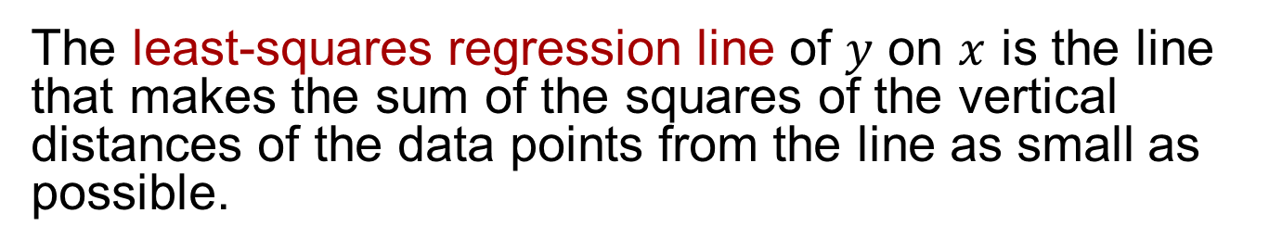
The least-squares regression line (or regression line)
The least-squares regression line of $y$ on $x$ is the line that makes the sum of the squares of the vertical distances of the data points from the line as small as possible.

Slide 53
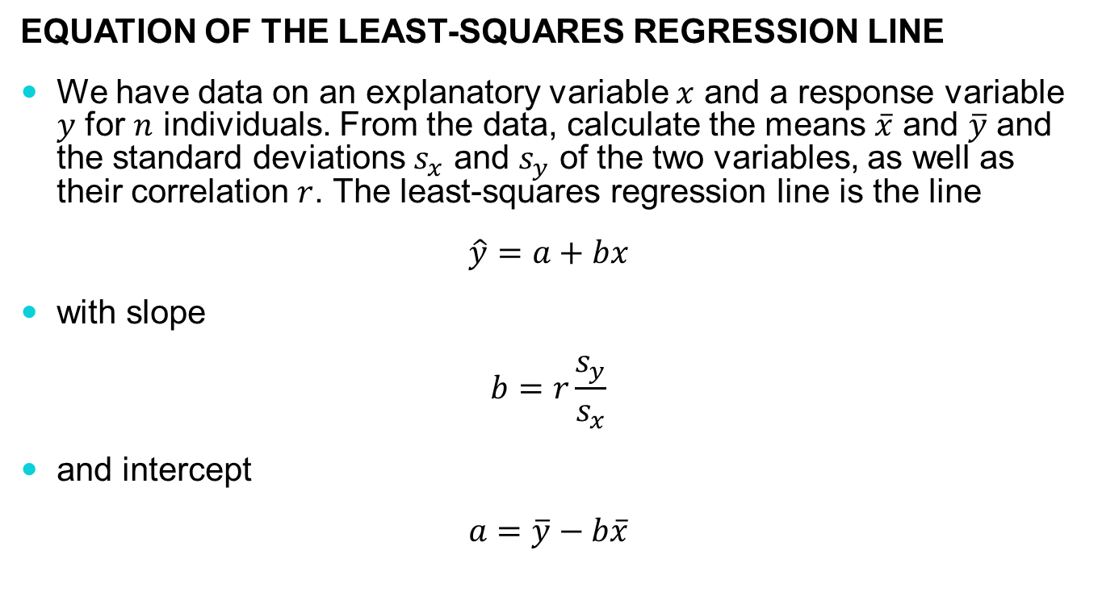
The least-squares regression line
Equation of the Least-squares regression line
We have data on an explanatory variable $x$ and a response variable $y$ for $n$ individuals. From the data, calculate the means $\overline{x}$ and $\overline{y}$ and the standard deviations $s_{x}$ and $s_{y}$ of the two variables, as well as their correlation $r$. The least-squares regression line is the line
$$\hat{y}=a+bx$$
with slope
$$b=r\frac{s_{y}}{s_{x}}$$
and intercept
$$a=\overline{y}−b\overline{x}$$

Slide 54
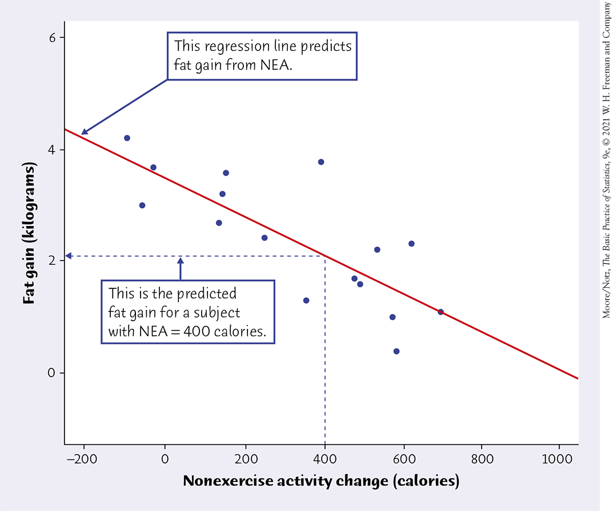

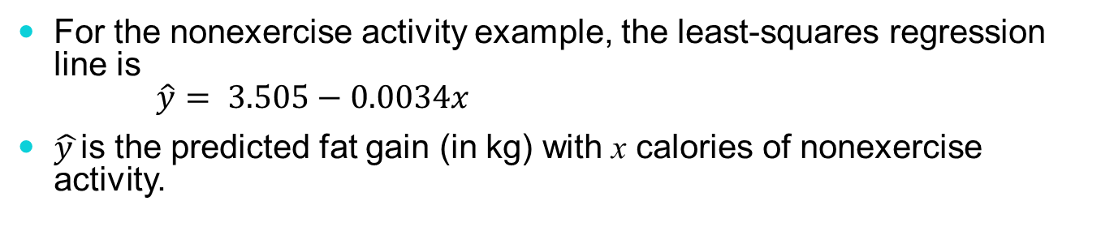
Prediction via regression line
For the nonexercise activity example, the least-squares regression line is $\hat{y}= 3.505−0.0034x$
$\hat{y }$is the predicted fat gain (in kg) with x calories of nonexercise activity.
Suppose we know someone has an increase of 400 calories of NEA. What would we predict for fat gain?
For someone with 400 calories of NEA, we would predict fat gain of
$$3.505−0.00344\left(400\right)=2.13 \text{kg}$$

Slide 55
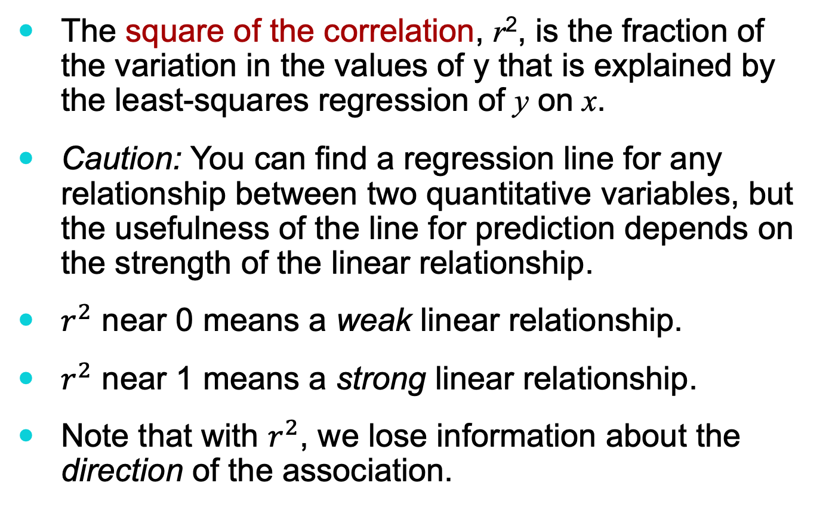
The square of the correlation
The square of the correlation, r², is the fraction of the variation in the values of y that is explained by the least-squares regression of y on x.
Caution: You can find a regression line for any relationship between two quantitative variables, but the usefulness of the line for prediction depends on the strength of the linear relationship.
$r^{2}$ near 0 means a weak linear relationship.
$r^{2}$ near 1 means a strong linear relationship.
Note that with $r^{2}$, we lose information about the direction of the association.

Slide 56
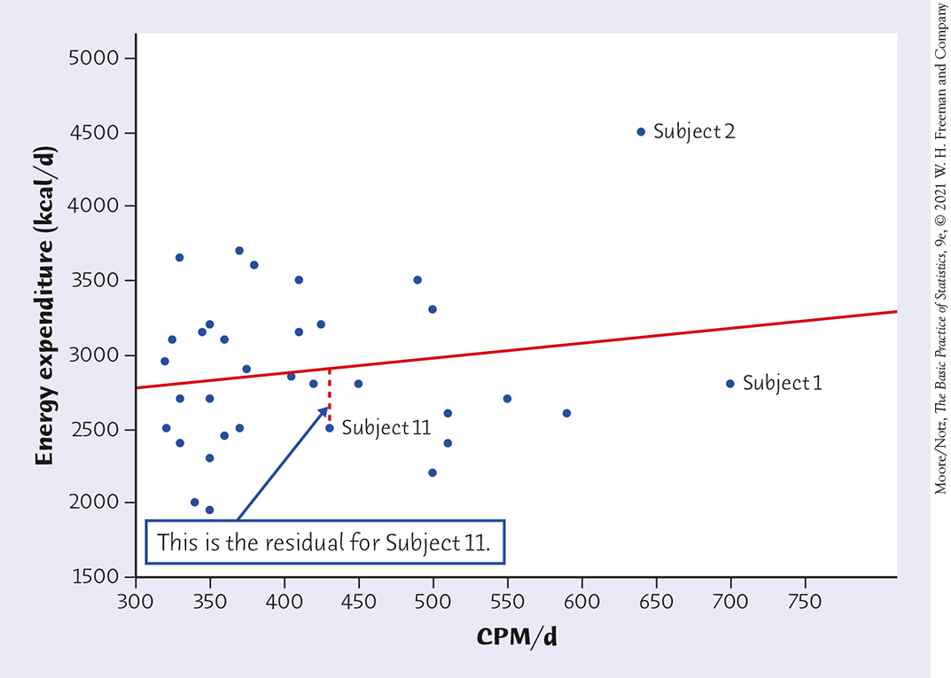
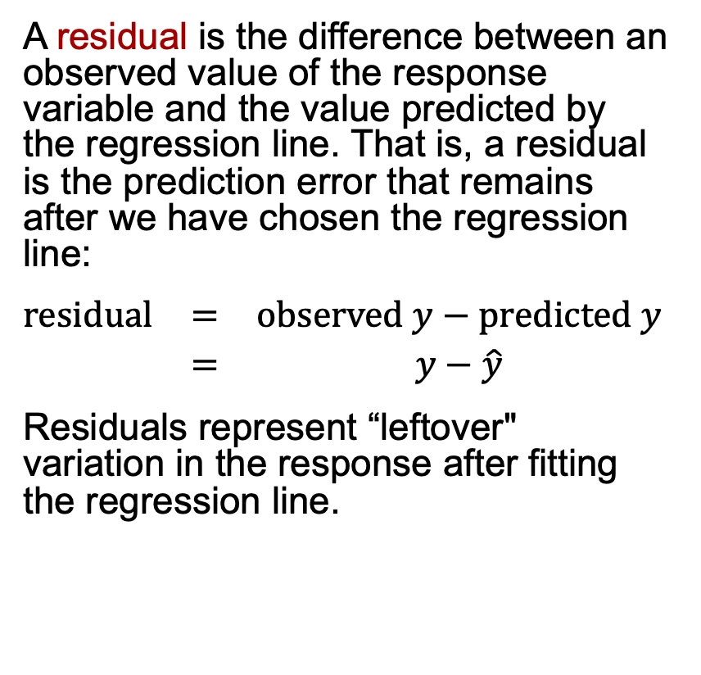
Residuals
A residual is the difference between an observed value of the response variable and the value predicted by the regression line. That is, a residual is the prediction error that remains after we have chosen the regression line:
$$\begin{matrix}\text{r}\text{esidual} & = & \text{observed} y−\text{predicted} y \\ & = & y−\hat{y}\end{matrix}$$
Residuals represent “leftover" variation in the response after fitting the regression line.
Example 5.5: researchers measured physical activity of 34 subjects, in mean counts per minute per day (CPM/d), using wearable accelerometers (fitbits). They also measured the total energy expenditure in kilocalories per day (kcal/d) for each subject.

Slide 57
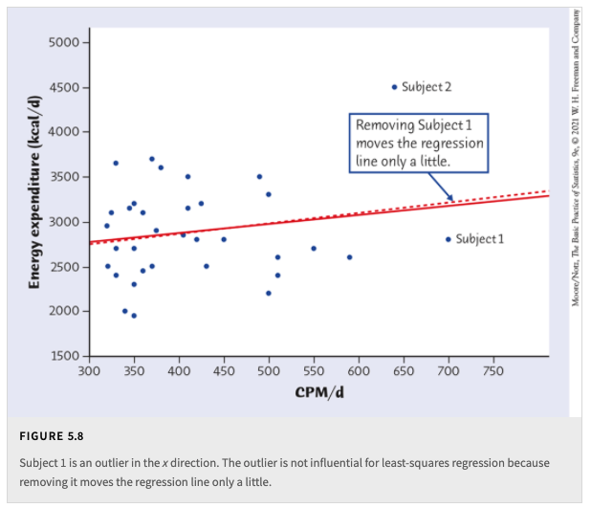
Outliers and influential points
Physical Activity and Weight Loss

Slide 58
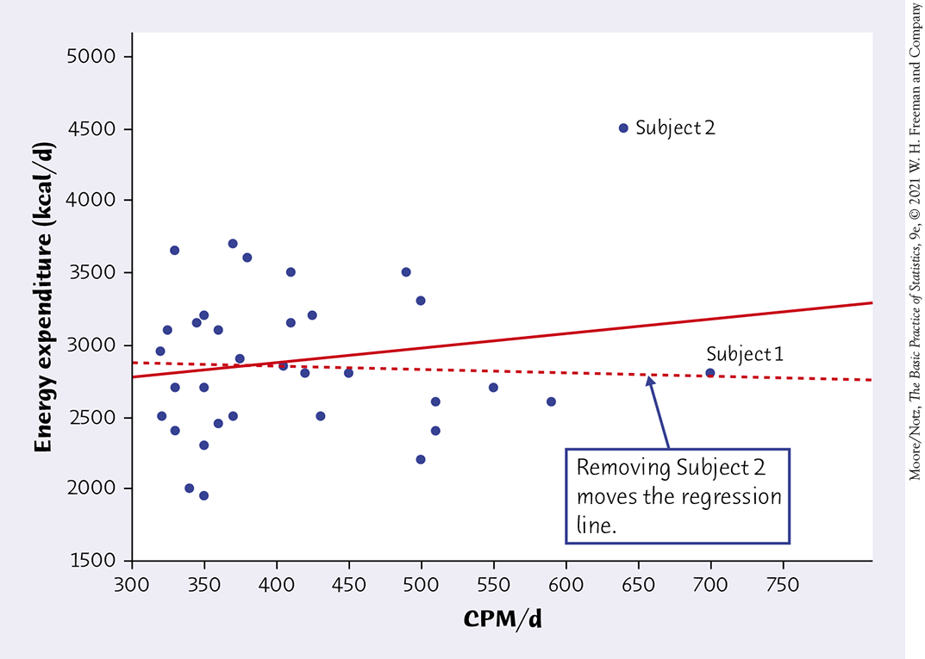


Outliers and influential points
Physical Activity and Weight Loss
From all of the data
$$r = 0.181$$
Without Subject 2
$$r =−0.043$$

Slide 59
Cautions about correlation and regression
Correlation and regression lines describe only linear relationships.
Correlation and least-squares regression lines are not resistant.
Beware ecological correlation, or correlation based on averages rather than individuals.
Beware of extrapolation—predicting outside of the range of x.
Beware of lurking variables—these have an important effect on the relationship among the variables in a study but are not included in the study.
Correlation does not imply causation!

Slide 60
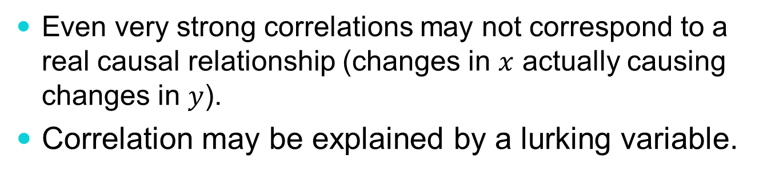
Correlation does not imply causation
Even very strong correlations may not correspond to a real causal relationship (changes in $x$ actually causing changes in $y$).
Correlation may be explained by a lurking variable.
Social Relationships and Health
House, J., Landis, K., and Umberson, D. “Social Relationships and Health,” Science, Vol. 241 (1988), pp. 540–545.
Does lack of social relationships cause people to become ill?
(There was a strong correlation.)
Or are unhealthy people less likely than others to establish and maintain social relationships? (reversed relationship)
Or is there some other factor that predisposes people both to have lower social activity and to become ill?

Slide 61
Evidence of causation
A properly conducted randomized experiment may establish causation.
Other considerations when we cannot do an experiment:
The association is strong.
The association is consistent.
Higher doses are associated with stronger responses.
Alleged cause precedes the effect in time.
Alleged cause is plausible (reasonable explanation).

Slide 62
In Chapter 6, we cover …
Marginal distributions
Conditional distributions
Relative risk and odds ratio for 2x2 contingency tables
Simpson’s paradox

Slide 63
Two-way contingency table
A two-way table describes two categorical variables, organizing counts according to a row variable and a column variable.
In 2017, the National Center for Education Statistics projected the number of academic degrees to be awarded in 2020–2021 for men and women (Table 6.1 of the textbook)
Sex | Degrees Conferred (thousands): Associate | Degrees Conferred (thousands): Bachelor’s | Degrees Conferred (thousands): Master’s | Degrees Conferred (thousands): Professional/Doctorate | Total
Women | 639 | 1087 | 460 | 97 | 2283
Men | 402 | 804 | 329 | 87 | 1622
Total | 1041 | 1891 | 789 | 184 | 3905

Slide 64
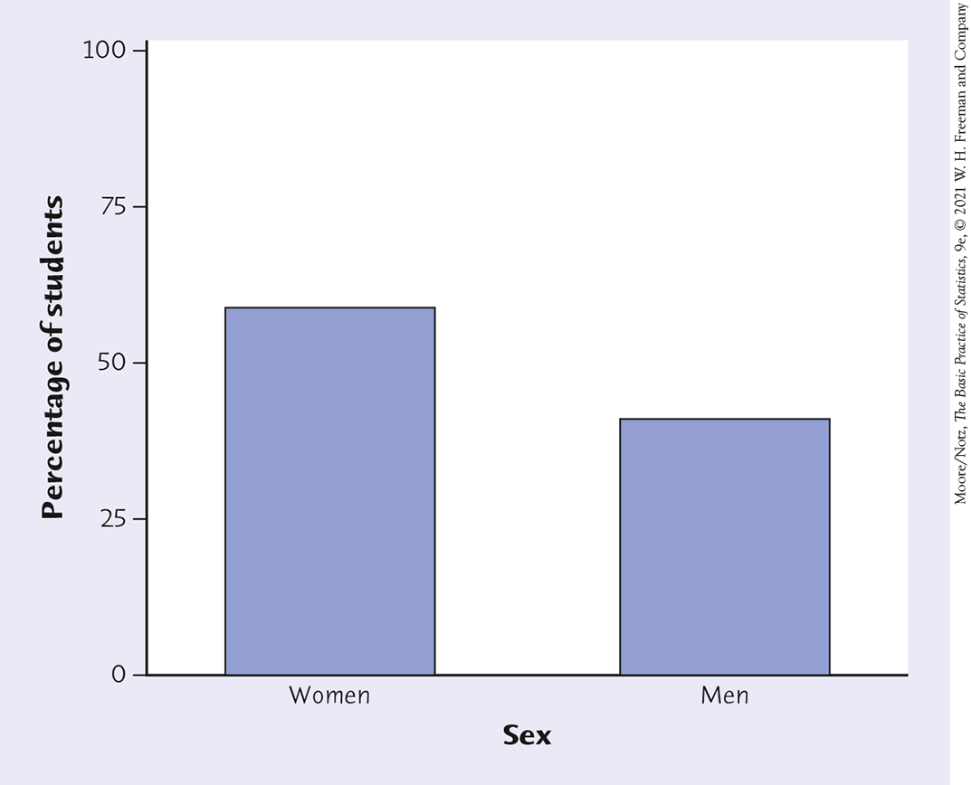
Marginal distribution
Sex | Degrees Conferred (thousands): Associate | Degrees Conferred (thousands): Bachelor’s | Degrees Conferred (thousands): Master’s | Degrees Conferred (thousands): Professional/Doctorate | Total
Women | 639 | 1087 | 460 | 97 | 2283
Men | 402 | 804 | 329 | 87 | 1622
Total | 1041 | 1891 | 789 | 184 | 3905
Examine the marginal distribution of sex.
Response | Percent
Women | 2283/3905= 58.5%
Men | 1622/3905 = 41.5%

Slide 65
Marginal distribution
Sex | Degrees Conferred (thousands): Associate | Degrees Conferred (thousands): Bachelor’s | Degrees Conferred (thousands): Master’s | Degrees Conferred (thousands): Professional/Doctorate | Total
Women | 639 | 1087 | 460 | 97 | 2283
Men | 402 | 804 | 329 | 87 | 1622
Total | 1041 | 1891 | 789 | 184 | 3905
Examine the marginal distribution of degree conferred.
Response | Percent
Associate | 1041/3905= 26.7%
Bachelor’s | 1891/3905 = 48.4%
Master’s | 789/3905 = 20.2%
Doctorate | 184/3905 = 4.7%

Slide 66
Conditional distribution
Sex | Degrees Conferred (thousands): Associate | Degrees Conferred (thousands): Bachelor’s | Degrees Conferred (thousands): Master’s | Degrees Conferred (thousands): Professional/Doctorate | Total
Women | 639 | 1087 | 460 | 97 | 2283
Men | 402 | 804 | 329 | 87 | 1622
Total | 1041 | 1891 | 789 | 184 | 3905
Examine the conditional distribution of degree conferred given that awardees are women
Proportion of Associate degrees received among all women: 639/2283 = 0.28
Proportion of Bachelor’s degrees received among all women: 1087/2283 = 0.48
Proportion of Master’s degrees received among all women: 460/2283 = 0.20
Proportion of PhD’s degrees received among all women: 97/2283 = 0.04
Similarly, we can also obtain the conditional distribution of degree conferred given that awardees are men.

Slide 67
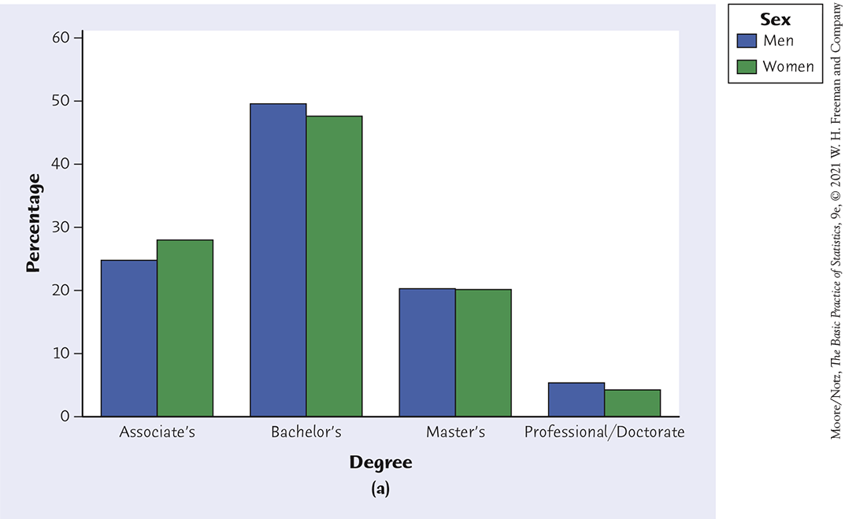
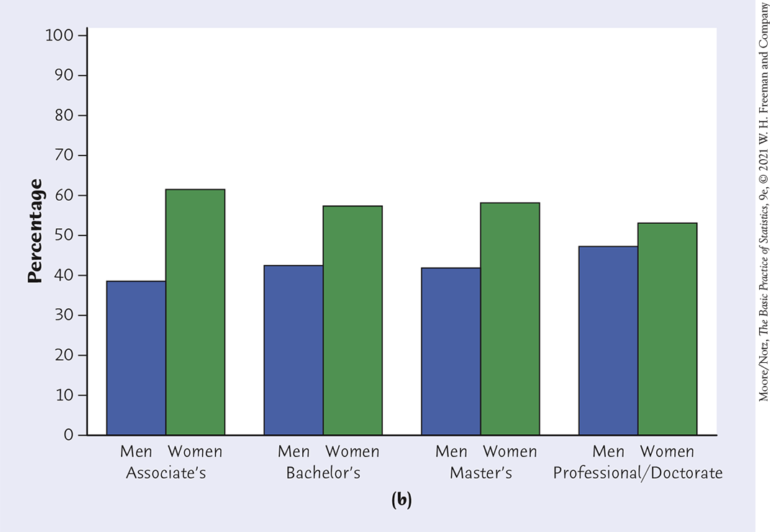
Conditional distribution
Conditional distribution of degree received given sex
Sum of the heights of the bars for mean should be 100%
Sum of the heights of the bars for women should be 100%
Conditional distribution of sex given degree received
Sum of the heights of the bars for men and women for each degree type should sum to 100%

Slide 68
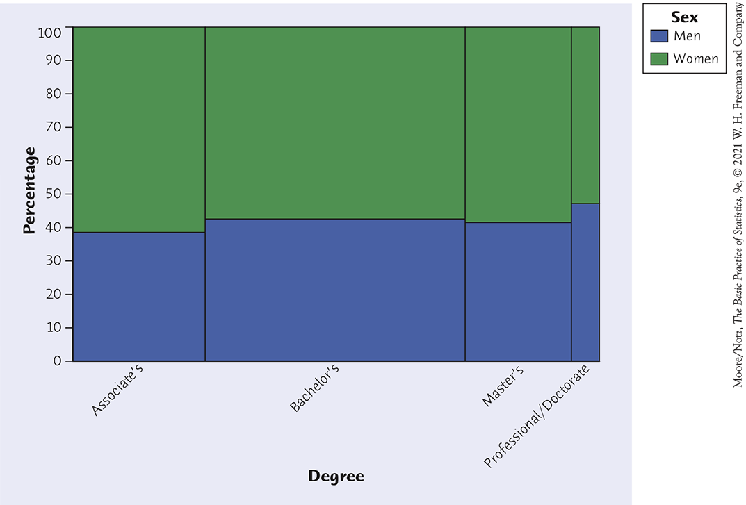
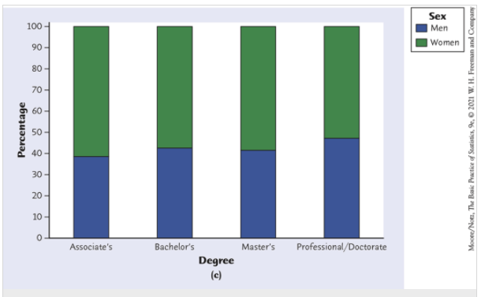
Conditional distribution
Other plots to show conditional distributions
Mosaic plot and segmented bar graph comparing the proportions of women (green) and men (blue) among those in each degree-conferred category.

Slide 69
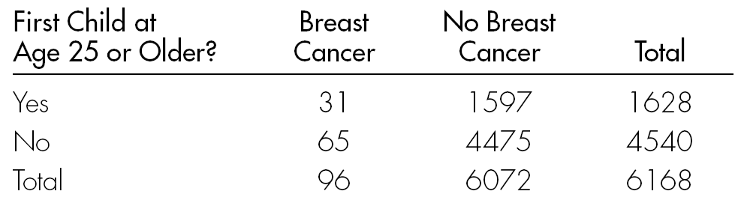
Relative risk and odds ratio for 2x2 contingency tables
Note: a 2x2 table is a two-way table where each categorical variable take only 2 categories
Example of 2x2 contingency table
Source: Pagano and Gauvreau (1988, p. 133).
Copyright ©2005 Brooks/Cole, a division of Thomson Learning, Inc.

Slide 70
Example: Relative Risk of
Developing Breast Cancer
Risk for women having first child at 25 or older = 31/1628 = 0.0190
Risk for women having first child before 25
= 65/4540 = 0.0143
Relative risk = 0.0190/0.0143 = 1.33
Risk of developing breast cancer is 1.33 times greater for women who had their first child at 25 or older.
Source: Pagano and Gauvreau (1988, p. 133).

Slide 71
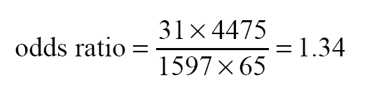
Odds Ratio
Odds Ratio: ratio of the odds of getting the disease to the odds of not getting the disease.
Example: Odds Ratio for Breast Cancer
Odds for women having first child at age 25 or older = 31/1597 = 0.0194
Odds for women having first child before age 25 = 65/4475 = 0.0145
Odds ratio = 0.0194/0.0145 = 1.34
Alternative formula:

Slide 72
Simpson’s paradox (2 of 4)
Consider the survival rates for the following groups of victims, who were taken to the hospital either by helicopter or by road.
A higher percent of those transported by helicopter died. Does this mean that this (more costly) mode of transportation isn’t helping?
Counts | Helicopter | Road
Victim died | 64 | 260
Victim survived | 136 | 840
Total | 200 | 1100
Percents | Died | Survived
Helicopter | 64/200=32% | 68%
Road | 260/1100=24% | 76%

Slide 73
Simpson’s paradox (3 of 4)
Consider the survival rates when broken down by type of accident.
Serious accidents
Less serious accidents
Counts | Helicopter | Road
Died | 48 | 60
Survived | 52 | 40
Total | 100 | 100
Counts | Helicopter | Road
Died | 16 | 200
Survived | 84 | 800
Total | 100 | 1000
Percents | Died | Survived
Helicopter | 48% | 52%
Road | 60% | 40%
Percents | Died | Survived
Helicopter | 16% | 84%
Road | 20% | 80%

Slide 74
Simpson’s paradox (4 of 4)
Lurking variable: Accidents were of two sorts—serious (100) and less serious (1000).
Helicopter evacuations had a higher survival rate within both types of accidents than did road evacuations.
This is not evidence of the inefficacy of helicopter evacuation!
This is an example of Simpson’s paradox.
When the lurking variable (type of accident: serious or less serious) is ignored, the data seem to suggest that road evacuations are safer than helicopter evacuations.
However, when the type of accident is considered, the association is reversed and suggests that helicopter evacuations are, in fact, safer.
Can be dangerous to summarize information over groups!

